Slide 1

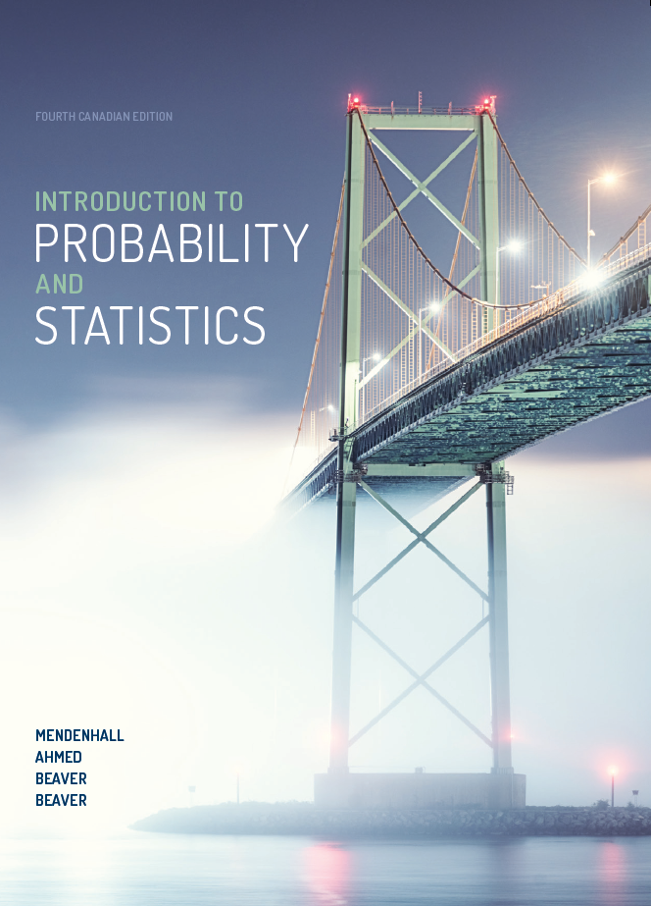
NETA PowerPoint® Slides
to accompany
Introduction to Probability and Statistics, 4Ce
Revised for the
Canadian edition by
Cristina Anton
Grant MacEwan University

Slide 2
CHAPTER 4
Probability and Probability Distributions

Slide 3
Review
In Chapters 2 and 3, we used graphs and numerical measures to describe data sets that were usually samples

Slide 4
What Is Probability?
We measured “how often” using:
As n gets larger:
Relative frequency = frequency/sample size
= f/n
Sample
and “How often”
= Relative frequency
Population
Probability

Slide 5
Events and the Sample Space
Experiment: the process by which an observation (or measurement) is obtained:
Experiment: record an age
Experiment: toss a die
Experiment: record an opinion (yes, no)
Experiment: toss two coins

Slide 6
Events and the Sample Space
A simple event is the outcome that is observed on a single repetition of the experiment
The basic element to which probability is applied
One and only one simple event can occur when the experiment is performed
A simple event is denoted by E with a subscript

Slide 7
Events and the Sample Space
Each simple event will be assigned a probability, measuring “how often” it occurs
The set of all simple events of an experiment is called the sample space, S

Slide 8
Example: The Die Toss
Simple events
Sample space
S = {E₁, E₂, E₃, E₄, E₅, E₆}
1
E₁
E₂
E₃
E₄
E₅
E₆
2
Die
face
S
3
E₁
E₃
4
E₅
5
E₂
E₆
E₄
6

Slide 9
Events and the Sample Space
An event is a collection of one or more simple events
The die toss:
A: an odd number
B: a number > 2
S
E₁
E₃
A
E₅
B
E₂
E₆
E₄
A = {E₁, E₃, E₅}
B = {E₃, E₄, E₅, E₆}

Slide 10
Events and the Sample Space
Two events are mutually exclusive if when one event occurs the other cannot, and vice versa
Experiment: Toss a die
A: Observe an odd number
B: Observe a number greater than 2
C: Observe a 6
D: Observe a 3
Not Mutually Exclusive
B and C?
B and D?
Mutually Exclusive

Slide 11
Calculating Probabilities Using Simple Events
The probability of an event A measures how often we think A will occur; we write P(A)
Suppose that an experiment is performed n times. The relative frequency for an event A is
If we let n get infinitely large,

Slide 12
Requirements for Simple Event Probabilities
Each probability must lie between 0 and 1
If event A can never occur, P(A) = 0
If event A always occurs when the experiment is performed, P(A) = 1
The sum of the probabilities for all simple events in S equals 1
The probability of an event A is found by adding the probabilities of all the simple events contained in A

Slide 13
Finding Probabilities
Probabilities can be found using
Estimates from empirical studies
Common sense estimates based on equally likely events
Examples:
Toss a fair coin:
77.1% of Canadians identified as Christians (C). Select a person at random:
P(Head) = 1/2
P(C) = .771

Slide 14
Example
Toss a fair coin twice. What is the probability of observing at least one head?
1st Coin 2nd Coin E_{i} P(E_{i})
P(at least 1 head)
= P(E₁) + P(E₂) + P(E₃)
= 1/4 + 1/4 + 1/4 = 3/4
H
HH
1/4
1/4
1/4
1/4
H
T
HT
H
TH
T
T
TT

Slide 15
Example
A bowl contains three M&Ms®: one red, one blue, and one green. A child selects two M&Ms at random. What is the probability that at least one is red?
1st M&M 2nd M&M E_{i} P(E_{i})
1/6
1/6
1/6
1/6
1/6
1/6
m
RB
m
P(at least 1 red)
= P(RB) + P(BR) + P(RG) + P(GR)
= 4/6 = 2/3
m
RG
m
BR
m
m
BG
m
GB
m
m
GR

Slide 16
Useful Counting Rules
If the simple events in an experiment are equally likely, you can calculate
You can use counting rules to find n_{A} and N

Slide 17
The mn Rule
If an experiment is performed in two stages, with m ways to accomplish the first stage and n ways to accomplish the second stage, then there are mn ways to accomplish the experiment
This rule is easily extended to k stages, with the number of ways equal to n₁ n₂ n₃ … n_{k}
Example: Toss two coins. The total number of simple events is:
2 × 2 = 4

Slide 18
Examples
Example: Toss three coins. The total number of simple events is:
Example: Toss two dice. The total number of simple events is:
Example: Two M&Ms are drawn from a dish containing two red and two blue candies. The total number of simple events is:
2 × 2 × 2 = 8
6 × 6 = 36
4 × 3 = 12

Slide 19
Permutations
The number of ways you can arrange n distinct objects, taking them r at a time, is

Slide 20
Example
How many 3-digit lock combinations can we make from the numbers 1, 2, 3, and 4?
The order of the choice is important!

Slide 21
Example
A piece of equipment is composed of five parts that can be assembled in any order. A test is to be conducted to determine the time necessary for each order of assembly. If each order is to be tested once, how many tests must be conducted?
The order of the choice is important!

Slide 22
Combinations
The number of distinct combinations of n distinct objects that can be formed, taking them r at a time, is

Slide 23
Example
A printed circuit board may be purchased from five suppliers. In how many ways can three suppliers be chosen from the five?
The order of the choice is not important!

Slide 24
Example
A box contains six M&Ms, four red and two green. A child selects two M&Ms at random. What is the probability that exactly one is red?
The order of
the choice is
not important!
4 ×2 = 8 ways to choose 1 red and 1 green M&M
P(exactly one red) = 8/15

Slide 25
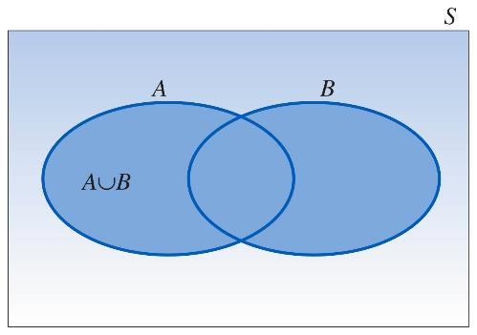
Event Relations
The union of two events, A and B, is the event that either A or B or both occur when the experiment is performed; we write A ∪ B

Slide 26
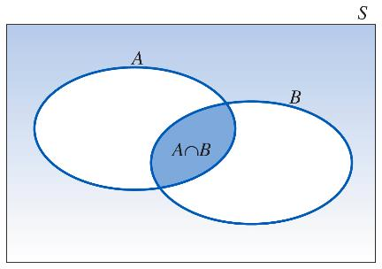
Event Relations
The intersection of two events, A and B, is the event that both A and B occur when the experiment is performed; we write A ∩ B
If two events A and B are mutually exclusive, then P(A ∩ B) = 0

Slide 27
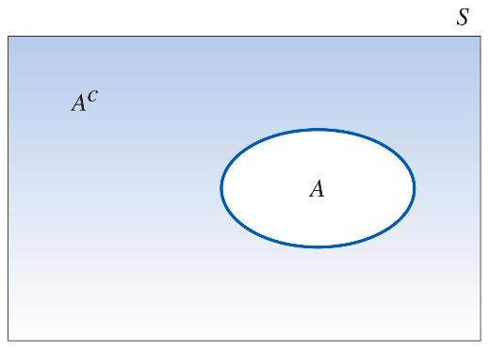
Event Relations
The complement of an event A consists of all outcomes of the experiment that do not result in event A; we write A^{C}

Slide 28
Example
Select a student from the classroom and record his/her hair colour and gender
A: student has brown hair
B: student is female
C: student is male
Mutually exclusive; B = C^{C}

Slide 29
Example (cont’d)
What is the relationship between events B and C?
–A^{C}:
–B∩C:
–B∪C:
Student does not have brown hair
Student is both male and female = ∅
Student is either male or female = all students = S

Slide 30
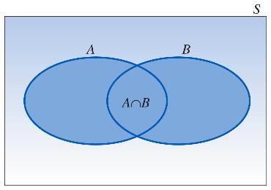
Calculating Probabilities for Unions and Complements
The Additive Rule for Unions:
For any two events A and B, the probability of their union, P(A ∪ B), is
Notes:
There are special rules that will allow you to calculate probabilities for composite events

Slide 31
Example: Additive Rule
Suppose there were 120 students in the classroom, and they could be classified as follows:
A: brown hair
P(A) = 50/120
B: female
P(B) = 60/120
 | Brown hair | Not brown hair
Male | 20 | 40
Female | 30 | 30
Notes:
Calculations on next slide.

Slide 32
Example: Additive Rule (cont’d)
P(A∪B) = P(A) + P(B) – P(A∩B)
= 50/120 + 60/120 – 30/120
= 80/120 = 2/3
Check: P(A∪B)
= (20 + 30 + 30)/120

Slide 33
A Special Case
When two events A and B are mutually exclusive, P(A∩B) = 0 and P(A∪B) = P(A) + P(B)
A: male with brown hair: P(A) = 20/120
B: female with brown hair: P(B) = 30/120
 | Brown hair | Not brown hair
Male | 20 | 40
Female | 30 | 30

Slide 34
A Special Case (cont’d)
P(A∪B) = P(A) + P(B)
= 20/120 + 30/120
= 50/120
A and B are mutually exclusive, so that

Slide 35
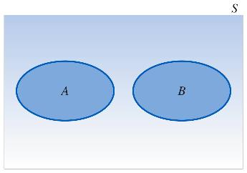
Calculating Probabilities for Complements
We know that for any event A:
P(A ∩ A^{C}) = 0
Since either A or A^{C} must occur,
P(A ∪ A^{C}) = 1
so that
P(A ∪ A^{C}) = P(A)+ P(A^{C}) = 1
P(A^{C}) = 1 – P(A)

Slide 36
Example
Select a student at random from the classroom and define:
A: male
P(A) = 60/120
B: female
 | Brown hair | Not brown hair
Male | 20 | 40
Female | 30 | 30
A and B are complementary, so that
P(B) = 1 – P(A)
= 1 – 60/120 = 60/120

Slide 37
Calculating Probabilities for Intersections
In the previous example, we found P(A ∩ B) directly from the table
Sometimes this is impractical or impossible
The rule for calculating P(A ∩ B) depends on the idea of independent and dependent events
Two events, A and B, are said to be independent if and only if the probability that event A occurs does not change, depending on whether or not event B has occurred

Slide 38
Conditional Probabilities
The probability that A occurs given that event B has occurred is called the conditional probability of A given B and is defined as
“given”

Slide 39
Example 1
Toss a fair coin twice and define:
A: head on second toss
B: head on first toss
P(A | B) = ½
P(A | not B) = ½
HH
1/4
1/4
1/4
1/4
P(A) does not change, whether B happens or not…
HT
A and B are independent!
TH
TT

Slide 40
Example 2
A bowl contains five M&Ms, two red and three blue. Randomly select two candies, and define:
A: second candy is red
B: first candy is blue
m
P(A | B) = P(2nd red | 1st blue) = 2/4 = 1/2
P(A | not B) = P(2nd red | 1st red) = 1/4
m
m
m
m
P(A) does change, depending on whether B happens or not…
A and B are dependent!

Slide 41
Defining Independence
We can redefine independence in terms of conditional probabilities:
Once you’ve decided whether or not two events are independent, you can use the following rule to calculate their intersection
Two events A and B are independent if and only if
P(A|B) = P(A) or P(B|A) = P(B)
Otherwise, they are dependent

Slide 42
The Multiplicative Rule for Intersections
For any two events, A and B, the probability that both A and B occur is
If the events A and B are independent, then the probability that both A and B occur is
P(A ∩ B) = P(A) P(B given that A occurred)
= P(A)P(B|A)
P(A ∩ B) = P(A) P(B)

Slide 43
Example 1
In a certain population, 10% of the people can be classified as being high risk for a heart attack. Three people are randomly selected from this population. What is the probability that exactly one of the three are high risk?

Slide 44
Example 1 Solution
Define H: high risk and N: not high risk
P(exactly one high risk) = P(HNN) + P(NHN) + P(NNH)
= P(H)P(N)P(N) + P(N)P(H)P(N) + P(N)P(N)P(H)
= (.1)(.9)(.9) + (.9)(.1)(.9) + (.9)(.9)(.1)= 3(.1)(.9)²
= .243

Slide 45
Example 2
Suppose we have additional information for the previous example. We know that only 49% of the population are female. Also, of the female patients, 8% are high risk. A single person is selected at random. What is the probability that it is a high-risk female?

Slide 46
Example 2 Solution
Define H: high risk and F: female
From the example, P(F) = .49 and P(H|F) = .08
Use the Multiplicative Rule:
P(high-risk female) = P(H∩F)
= P(F)P(H|F) =.49(.08)
= .0392

Slide 47
The Law of Total Probability
Let S₁, S₂ , S₃, ..., S_{k} be mutually exclusive and exhaustive events (that is, one and only one must happen)
Then the probability of another event A can be written as:
P(A) = P(A ∩ S₁) + P(A ∩ S₂) + … + P(A ∩ S_{k})
= P(S₁)P(A|S₁) + P(S₂)P(A|S₂) + … +
P(S_{k})P(A|S_{k})

Slide 48
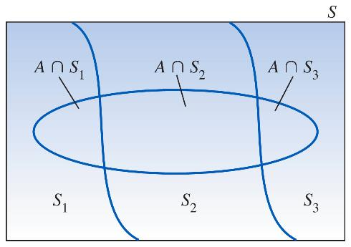
The Law of Total Probability
P(A) = P(A ∩ S₁) + P(A ∩ S₂) + … + P(A ∩ S_{k})
= P(S₁)P(A|S₁) + P(S₂)P(A|S₂) + … + P(S_{k})P(A|S_{k})

Slide 49
Bayes’ Rule
Let S₁, S₂, S₃, ..., S_{k} be mutually exclusive and exhaustive events with prior probabilities P(S₁), P(S₂),…,P(S_{k})
If an event A occurs, the posterior probability of S_{i}, given that A occurred, is

Slide 50
Example
From a previous example, we know that 49% of a population are female. Of the female patients, 8% are high risk for heart attack, while 12% of the male patients are high risk. A single person is selected at random and found to be high risk.
What is the probability that it is a male?

Slide 51
Example (cont’d)
Define H: high risk, F: female, and M: male
We know:
P(F) =
P(M) =
P(H|F) =
P(H|M) =
.49
.51
.08
.12

Slide 52
Random Variables
A quantitative variable x is a random variable if the value that it assumes, corresponding to the outcome of an experiment, is a chance or random event
Random variables can be discrete or continuous

Slide 53
Examples
x = SAT score for a randomly selected student
x = number of people in a room at a randomly selected time of day
x = number on the upper face of a randomly tossed die

Slide 54
Probability Distributions for Discrete Random Variables
The probability distribution for a discrete random variable x resembles the relative frequency distributions we constructed in Chapter 1
Notes:
It is a graph, table, or formula that gives the possible values of x and the probability p(x) associated with each value

Slide 55

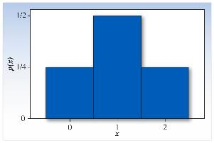
Example
Toss two fair coins and define x = number of heads
x
2
1
1
0
P(x = 0) = 1/4
P(x = 1) = 2/4 = 1/2
P(x = 2) = 1/4
HH
1/4
1/4
1/4
1/4
HT
TH
TT
x | p(x)
0 | 1/4
1 | 1/2
2 | 1/4
Probability histogram for x
Notes:
Link applet, p. 173
Figure 4.15, p. 174

Slide 56
Probability Distributions
Shape: Symmetric, skewed, mound-shaped…
Outliers: unusual or unlikely measurements
Centre and spread: mean and standard deviation
A population mean is called μ and a population standard deviation is called σ

Slide 57
The Mean and Standard Deviation
Let x be a discrete random variable with probability distribution p(x)
Then the mean, variance, and standard deviation of x are given as

Slide 58
Example
Toss a fair coin 2 times and record x the number of heads:
x | p(x) | xp(x) | (x–μ)²p(x)
0 | 1/4 | 0 | (–1)²(1/4)
1 | 1/2 | 1/2 | (0)²(1/2)
2 | 1/4 | 1/2 | (1)²(1/4)

Slide 59

Example
The probability distribution for x the number of heads in tossing 2 fair coins
Symmetric; mound-shaped
Shape?
Outliers?
Centre?
Spread?
None
μ = 1
σ = .71
μ
Notes:
Figure 4.15, p. 174

Slide 60
Key Concepts, Part I
I. Experiments and the Sample Space
1. Experiments, events, mutually exclusive events, simple events
2. The sample space
3. Venn diagrams, tree diagrams, probability tables

Slide 61
Key Concepts, Part II
II. Probabilities
1. Relative frequency definition of probability
2. Properties of probabilities
a. Each probability lies between 0 and 1
b. Sum of all simple-event probabilities equals 1
3. P(A), the sum of the probabilities for all simple events in A

Slide 62
Key Concepts, Part III
III. Counting Rules
1. mn Rule; extended mn Rule
2. Permutations:
3. Combinations

Slide 63
Key Concepts, Part IV
IV. Event Relations
1. Unions and intersections
2. Events
a. Disjoint or mutually exclusive: P(A ∩ B) = 0
b. Complementary: P(A) = 1 – P(A^{C})

Slide 64
Key Concepts, Part IV (cont’d)
3. Conditional probability:
4. Independent and dependent events
5. Additive Rule of Probability:
6. Multiplicative Rule of Probability:
7. Law of Total Probability
8. Bayes’ Rule

Slide 65
Key Concepts, Part V
V. Discrete Random Variables and
Probability Distributions
1. Random variables, discrete and continuous
2. Properties of probability distributions
3. Mean or expected value of a discrete random variable:

Slide 66
Key Concepts, Part V (cont’d)
4. Variance and standard deviation of a discrete random variable:

